Slide 1
Structuring Your Dealership
to Maximise Profit
Bob Clements
Bob Clements International

Slide 2
Structuring Your Dealership
to Maximize Profit
Bob Clements
Bob Clements International

Slide 3
Creating High Performance
Why are dealers in business?

Slide 4
Creating High Performance

Slide 5
Creating High Performance
It starts with process.
You can’t manage what you don’t measure.

Slide 6
Equipment Sales
Equipment sales act as the fuel for the dealership.

Slide 7
Equipment Sales
How do you track the amount of touches you are making a day, week or month and what is the value of each one?

Slide 8
Parts Sales
Define your pricing strategy.
Turns vs. Margins
Margins
Variable/Tiered
Velocity

Slide 9
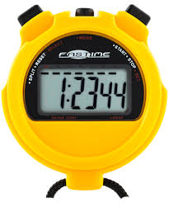
Parts Sales
Time
Transactions
Fill Rate
Percent out of inventory

Slide 10
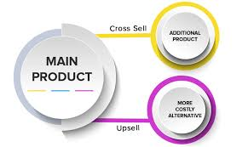
Parts Sales
Upselling
Cross Selling

Slide 11
Service
Time is your product and tracking it is the key to running a profitable service department.

Slide 12
Maximize Your Profits
Questions?

